Slide 1
Chapter 4. Threads
CSci 474: Operating Systems Instructor: Dr. Jun Kong

Slide 2
Process
Resource - process includes a virtual address space to hold the process image
Scheduling/execution- follows an execution path that may be interleaved with other processes
These two characteristics are treated independently by the operating system

Slide 3
Threads
If splitting into two parts, we have:
Process: owns resources
Thread: executes

Slide 4
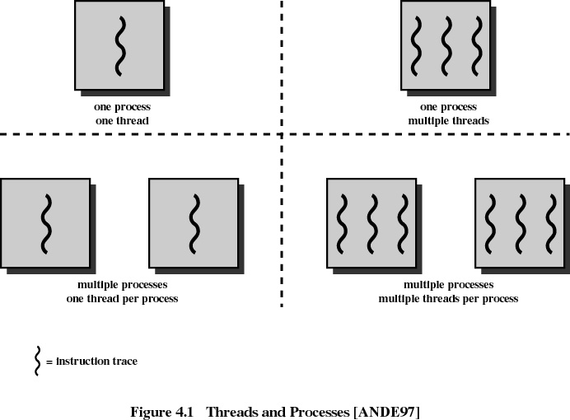

Slide 5
Multithreading
Multithreading refers to multiple threads of execution in a single process.
A process that is not multithreaded is called single-threaded.
OS and threads
  MS-DOS supports a single thread
  UNIX supports multiple user processes but only supports one thread per process
  Windows, Solaris, Linux, and OS/2 support multiple threads

Slide 6
Process and thread
Process:
Have a virtual address space which holds the process image
Resource : Protected access to processors, other processes, files, and I/O resources.
Thread:
Thread execution state (running, etc.)
Thread context
Stack
Local variables
Shared access to memory and resources of its process

Slide 7
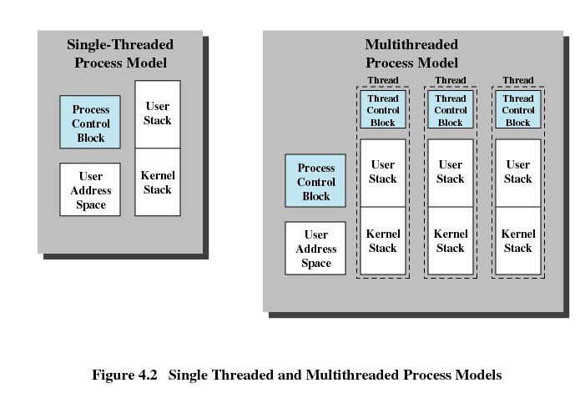

Slide 8
Thread VS process
Takes less time to create a new thread than a process
Less time to terminate a thread than a process
Less time to switch between two threads within the same process
Since threads within the same process share memory and files, they can communicate with each other without invoking the kernel

Slide 9
Threads
Scheduling and dispatching may be done on a thread basis rather than a process basis.
  running, ready and blocked
Suspending and termination
  However, suspending a process involves suspending all threads of the process since all threads share the same address space.
  Termination of a process would terminate all threads within the process.

Slide 10
Thread Example
Suppose a file server receives requests from various clients.
The file server could create a new thread for each request.
On a multiprocessor machine the threads could even run simultaneously.
Thread efficiency seen especially if threads must communicate or coordinate.
Threads can make program organization easier.

Slide 11
Other Thread Examples
Foreground and background work: example: spreadsheet, one thread for user interaction and one for executing commands.
Asynchronous processing: word processor, thread to periodically save to disk.
Speed-up execution: overlapping activity (read and process) especially on a multiprocessor.
Modularity: programs that involve a variety of activities may be easier to design and implement using threads.

Slide 12
Parallelism in Threads
A key benefit of threads is to achieve a speed-up in execution through parallelism.
For example, a program might have two activities that could be done in parallel.
If these activities are done in sequence, it will take a certain amount of time to complete.
But if the activities are done in parallel, by using a separate thread for each, then the activities could complete twice as fast.

Slide 13
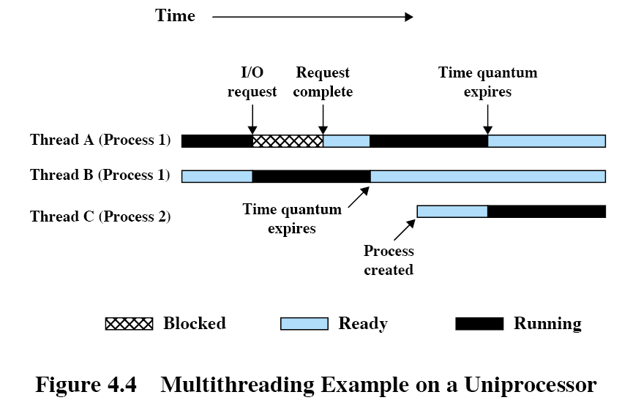
Thread interleaving

Slide 14
Thread Synchronization
Threads share the resources of their process.
Because of this their activities may need to be coordinated.
For example, if two threads of a process are operating on the same linked-list, it is important that they not interfere with each other or the list could be corrupted.

Slide 15
Thread Blocking
Does blocking a thread block its process?
If so, then the threading benefit is reduced since we would like one thread to run in our application while another is blocked.
The answer to this depends on the type of threading in use.
  User-level threads
  Kernel-level threads
Menti: 72152076

Slide 16
User-Level and Kernel-Level Threads
User-Level Threads: the application supports threading through a thread library and the OS isn’t aware of threads.
Kernel-Level Threads: the operating system supports threads itself.

Slide 17
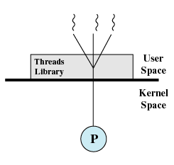
User-Level Threads

Slide 18
User-Level Threads
A process may use a thread library to create separate threads within itself.
These threads are application-level threads, the OS isn’t aware of them, it just schedules the process as usual.
The application’s thread library determines which of the application’s threads to run whenever the process is scheduled.
The application can spawn new threads which are managed by the thread library.
So, the OS runs the process, and the process uses a library to create and manage its threads.

Slide 19
User-Level Threads
Advantages
  Thread switching does not involve the kernel: no mode switching
  Scheduling can be application specific: choose the best algorithm.
  Can run on any OS. Only needs a thread library
Disadvantages
  Most system calls are blocking for processes. So all threads within a process will be blocked
  The kernel can only assign processes to processors. Two threads within the same process cannot run simultaneously on two processors
Menti: 69808811

Slide 20
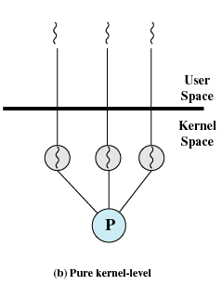
Kernel-Level Threads

Slide 21
Kernel-Level Threads
The OS may be designed to support threads itself.
The application creates threads by calling operating system functions (an API).
The OS schedules and manages individual threads rather than entire processes.

Slide 22
Kernel-Level Threads
Advantages
  the kernel can simultaneously schedule many threads of the same process on many processors
  blocking is done on a thread level, so one thread in a process can block while another runs (doesn’t block the entire process)
  kernel routines can be multithreaded
Disadvantages
  thread switching within the same process requires a mode switch to the kernel, which may result in a significant slow down.
Menti: 19844573

Slide 23
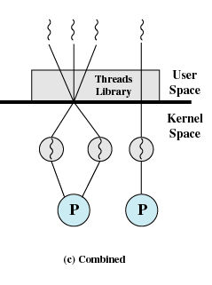
Combined Approaches

Slide 24
Combined Approaches
Solaris uses a combined approach to threads.
Solaris let’s applications create threads in user space that are then mapped onto an available pool of threads maintained by the kernel.
This approach gets much of the efficiency of ULTs without the problem of blocking all threads of a process.
The number of KLTs for an application may be specified by the programmer for best performance.

Slide 25
Windows Processes
Implemented as objects
An executable process may contain one or more threads
Both processes and thread objects have built-in synchronization capabilities

Slide 26
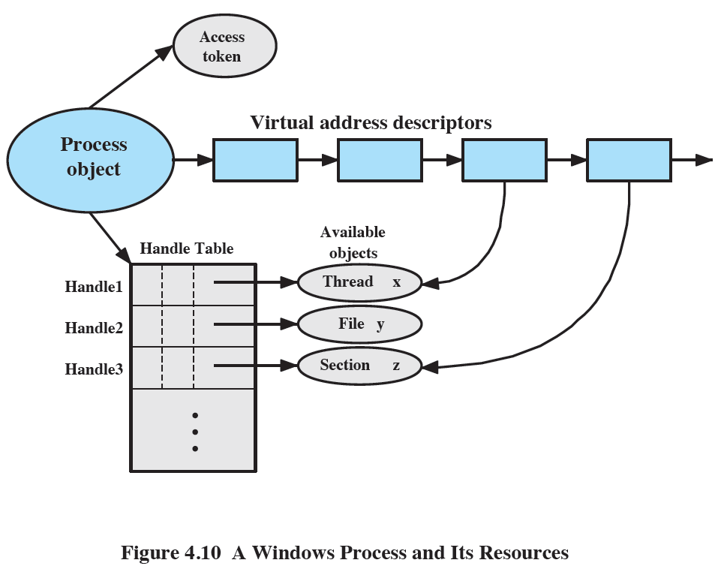

Slide 27
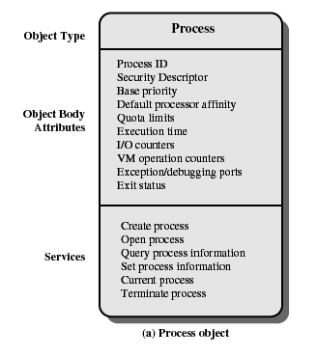
Windows Process Object

Slide 28
Attributes
Process ID: a unique value that identifies the process to the operating system
Security descriptor: Describes who created an object, who can gain access to or use the object, and who is denied access to the object
Base priority: a baseline execution priority for the process’s threads
Default processor affinity: the default set of processors on which the process’s threads can run
Quota limits: the maximum amount of paged and nonpaged system memory, paging file space, and processor time a user’s process can use.
Execution time: the total amount of time all threads in the process have executed
I/O counters: variables that record the number and type of I/O operations that the process’s threads have performed

Slide 29
VM operation counters: variables that record the number and types of virtual memory operations that the process’s threads have performed
Exception/debugging ports: interprocess communication channels to which the process manager sends a message when one of the process’s threads causes an exception
Exit status: the reason for a process’s termination

Slide 30
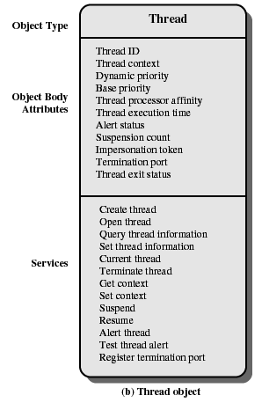
Windows Thread Object

Slide 31
Thread object attributes
Thread ID: a unique value that identifies a thread
Thread context: the set of register values and other volatile data that defines the execution state of a thread
Dynamic priority: the thread’s execution priority at any given moment
Base priority: the lower limit of the thread’s dynamic priority
Thread processor affinity: the set of processors on which the thread can run, which is a subset or all of the processor affinity of the thread’s process
Thread execution time: the cumulative amount of time a thread has executed in user mode an in kernel mode
Alert status: a flag that indicates whether the thread should execute an asynchronous procedure call

Slide 32
Suspension count: the number of times the thread’s execution has been suspended without being resumed
Impersonation token: a temporary access token allowing a thread to perform operations on behalf of another process
Termination port: an interprocess communication channel to which the process manager sends a message when the thread terminates
Thread exit status: the reason for a thread’s termination

Slide 33
Windows thread states
Ready
Standby: a standby thread has been selected to run next on a particular processor
Running
Waiting
Transition: a thread enters this state after waiting if it is ready to run but the resources are not available
Terminated

Slide 34
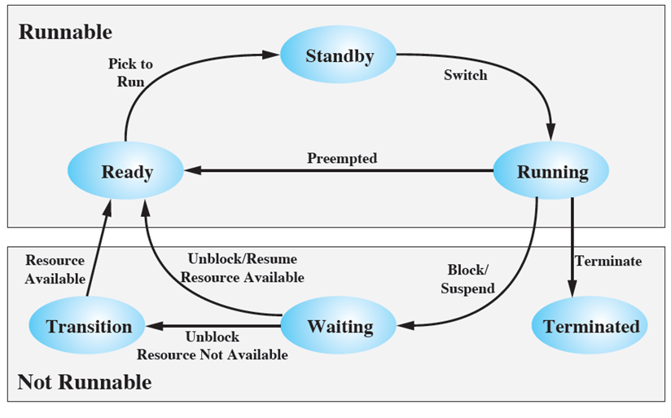
Figure 4.11 Windows Thread States

Slide 35
Solaris
Solaris implements an unusual multilevel thread support
Process includes the user’s address space, stack, and process control block
User-level threads (ULTs): implemented through a threads library in the address space of a process (invisible to the OS)
Lightweight processes (LWP): a lightweight process can be viewed as a mapping between ULTs and kernel threads
Kernel threads: the fundamental entities that can be scheduled and dispatched to run

Slide 36
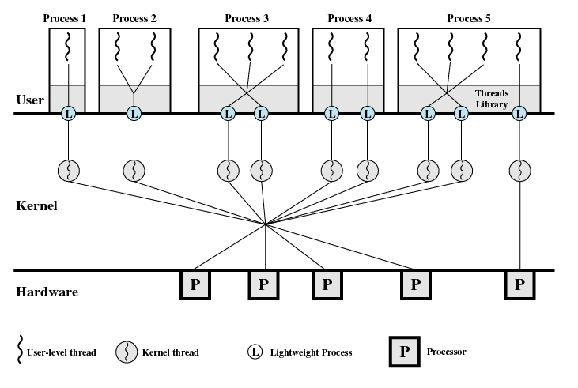

Slide 37
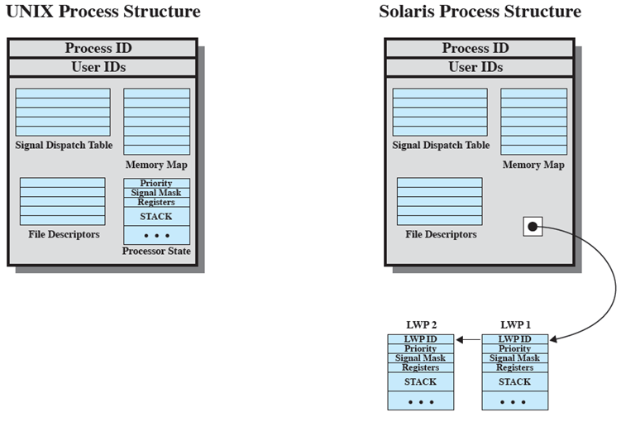
Figure 4.13 Process Structure in Traditional UNIX and Solaris [LEWI96]

Slide 38
Solaris Lightweight Process Data Structure
Identifier
Priority
Signal mask
Saved values of user-level registers
Kernel stack
Resource usage and profiling data
Pointer to the corresponding kernel thread
Pointer to the process structure

Slide 39
Linux threads
User level threads are mapped into kernel-level processes
Multiple user-level threads that constitute a single user-level process are mapped into Linux kernel level processes that share the same group ID.
  Those processes share resources (such as files and memory)

Slide 40
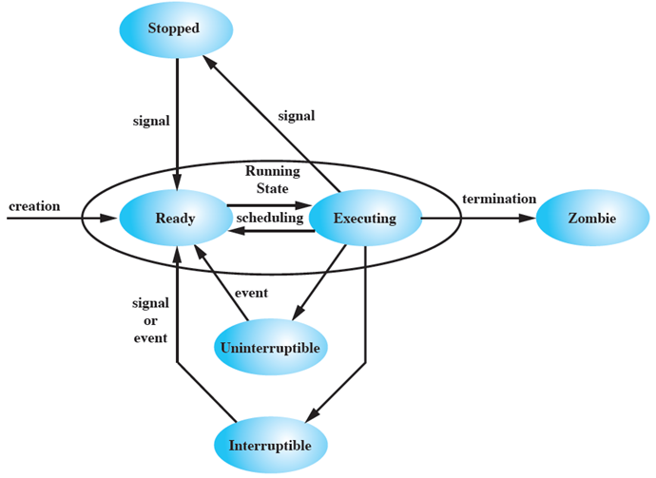
Figure 4.15 Linux Process/Thread Model

